Slide 1
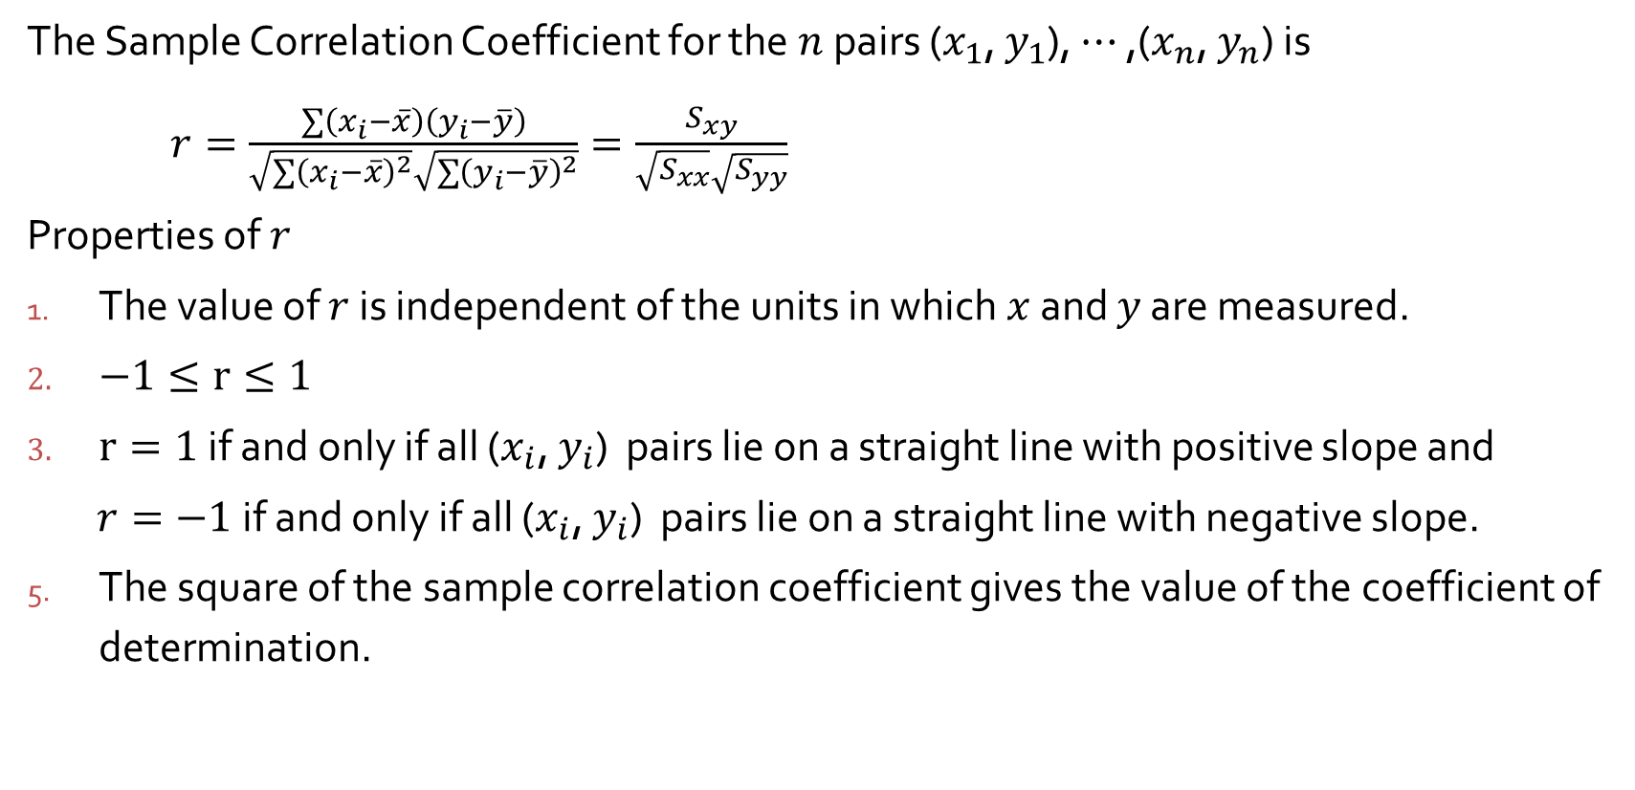
12.5 Correlation
The Sample Correlation Coefficient for the $n$pairs ($x_{1}$, $y_{1}$), $⋯$ ,($x_{n}$, $y_{n}$) is
$r=\frac{\sum{\left(x_{i}−\overline{x}\right)}\left(y_{i}−\overline{y}\right)}{\sqrt{\sum{{\left(x_{i}−\overline{x}\right)}^{2}}}\sqrt{\sum{{\left(y_{i}−\overline{y}\right)}^{2}}}}=\frac{S_{xy}}{\sqrt{S_{xx}}\sqrt{S_{yy}}}$
Properties of $r$
The value of $r$ is independent of the units in which $x$ and $y$ are measured.
$−1≤r≤1$
$r=1$if and only if all ($x_{i}$, $y_{i}$) pairs lie on a straight line with positive slope and
$r=−1$if and only if all ($x_{i}$, $y_{i}$) pairs lie on a straight line with negative slope.
The square of the sample correlation coefficient gives the value of the coefficient of determination.

Slide 2
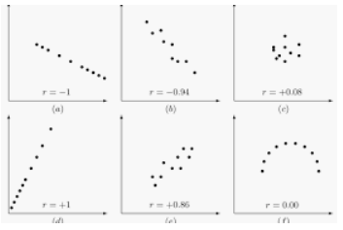

Slide 3
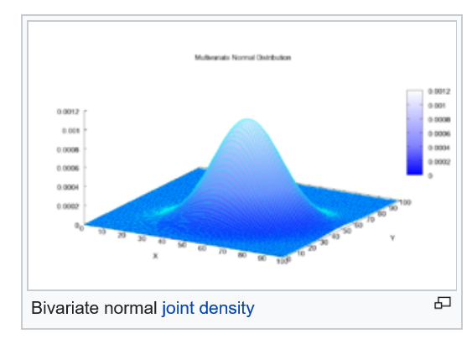

12.5 Correlation
Assumption
The joint probability distribution of ($X, Y)$ is specified by
$f\left(x, y\right)=\frac{1}{2πσ_{1}σ_{2}\sqrt{1−ρ^{2}}}e^{−\left[{\left(\frac{x−μ_{1}}{σ_{1}}\right)}^{2}−\frac{2ρ\left(x−μ_{1}\right)\left(y−μ_{2}\right)}{σ_{1}σ_{2}}+{\left(\frac{y−μ_{2}}{σ_{2}}\right)}^{2}\right]/\left[2\left(1−ρ^{2}\right)\right]}$
$−∞<X<∞,−∞<Y<∞$
$f\left(x,y\right)$ is called the bivariate normal
probability distribution.

Slide 4
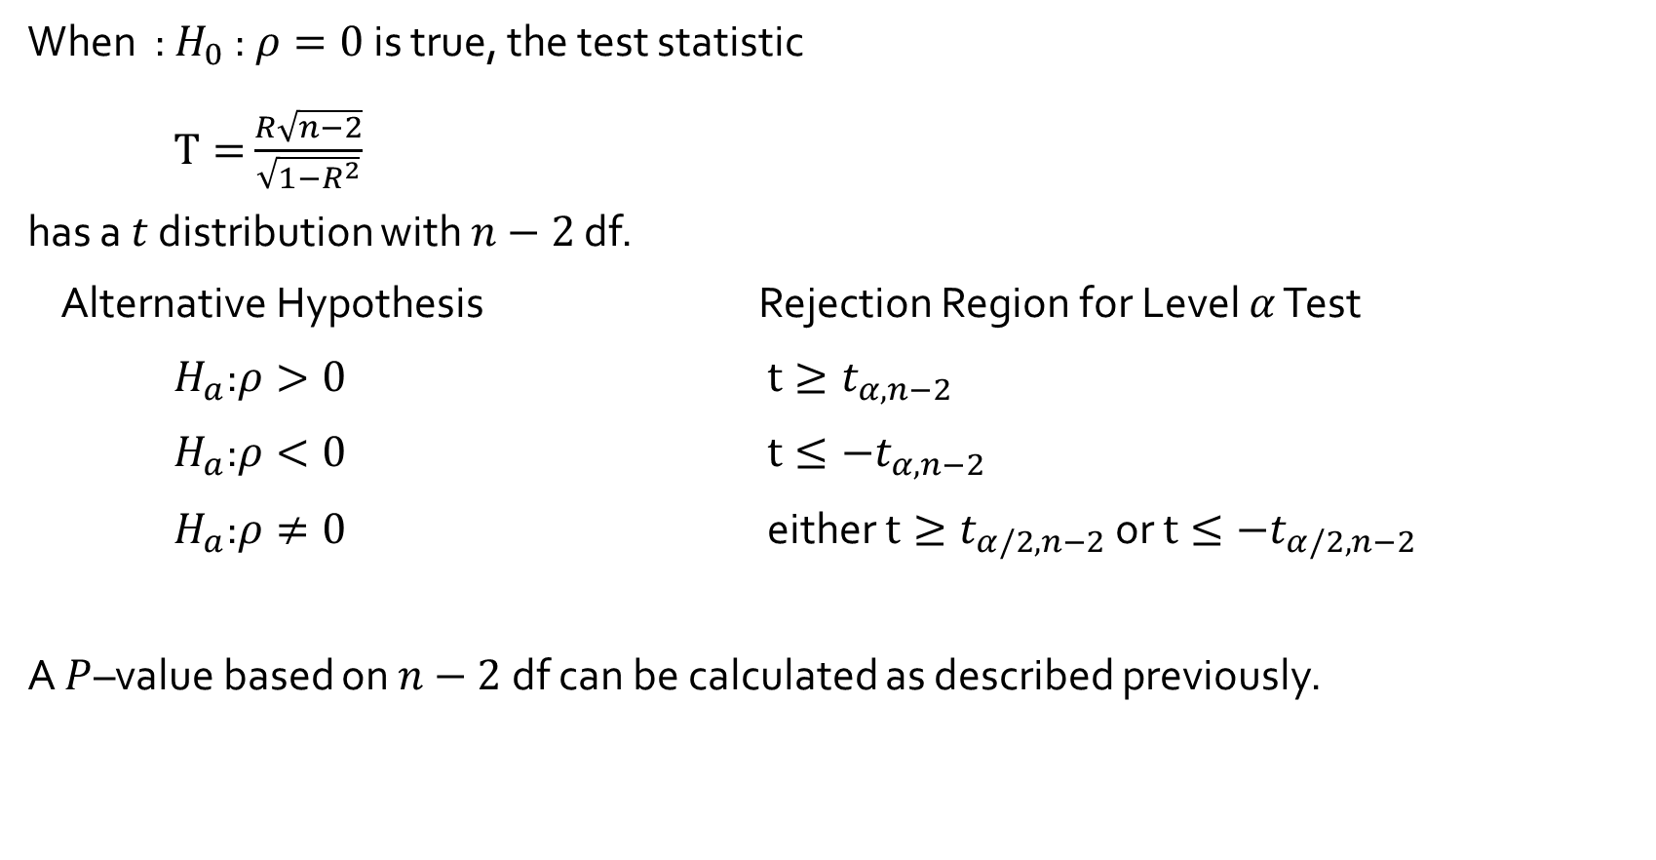
Testing for the Absence of Correlation
When : $H_{0}$ :$ρ=0$ is true, the test statistic
$T=$ $\frac{R\sqrt{n−2}}{\sqrt{1−R^{2}}}$
has a $t$ distribution with $n−2$ df.
Alternative Hypothesis Rejection Region for Level $α$ Test
$H_{a}$:$ρ>0$ $t≥t_{α,n−2}$
$H_{a}$:$ρ<0$ $t≤−t_{α,n−2}$
$H_{a}$:$ρ≠0$ either $t≥t_{α/2,n−2}$ or $t≤−t_{α/2,n−2}$
A $P$–value based on $n−2$df can be calculated as described previously.

Slide 5
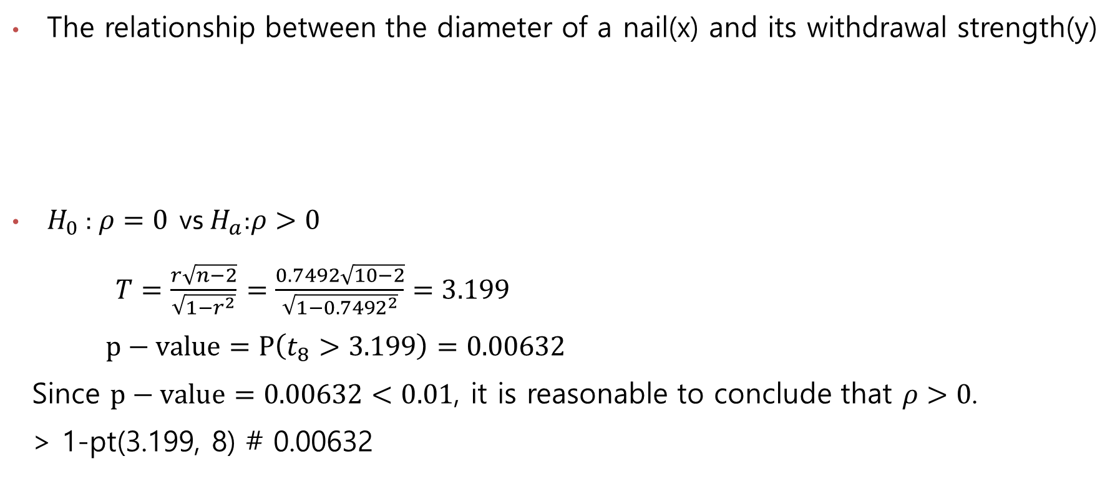
The relationship between the diameter of a nail(x) and its withdrawal strength(y)
$H_{0}$ :$ρ=0$ vs $H_{a}$:$ρ>0$
$T=\frac{r\sqrt{n−2}}{\sqrt{1−r^{2}}}$ $=\frac{0.7492\sqrt{10−2}}{\sqrt{1−{0.7492}^{2}}}=3.199$
$p−value=P\left(t_{8}>3.199\right)=0.00632$
Since $p−value=0.00632<0.01$, it is reasonable to conclude that $ρ>0$.
> 1-pt(3.199, 8) # 0.00632
x | 2.52 2.87 3.05 3.43 3.68 3.76 3.76 4.50 4.50 5.26
y | 54.74 59.01 72.92 50.85 54.99 60.56 69.08 77.03 69.97 90.70

Slide 6
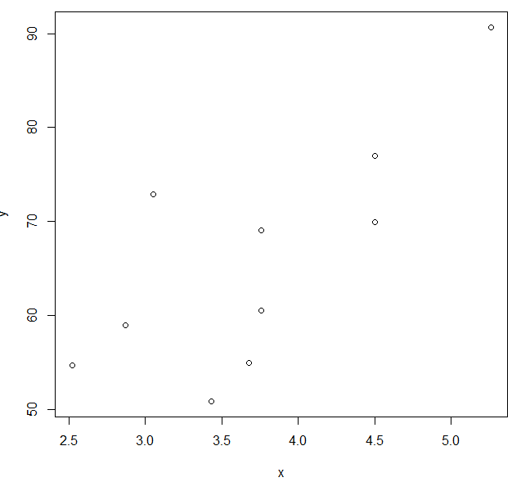
> x <- c(2.52, 2.87, 3.05, 3.43, 3.68, 3.76, 3.76, 4.50, 4.50, 5.26)
> y <- c(54.74, 59.01, 72.92, 50.85, 54.99, 60.56, 69.08, 77.03, 69.97, 90.70)
> plot(x, y)
> cor(x, y)
[1] 0.7491725

